Slide 1



Project Phase-II Review-2 Course Code: BEE786 PORTABLE NEONATAL INCUBATOR WITH SLEEP APNEA MONITORING
Presented By,
Chinthan A D 4AD22EE013
Kruthin H K 4AD22EE026
N Likitha 4AD22EE036
Sanjana B R 4AD22EE044
Under the Guidance of,
Mr. Shreeshayana R
Assistant Professor
Department of Electrical & Electronics Engineering
ATME College of Engineering, Mysuru
PROJECT PHASE-II
Date: 17-09-2025
ATME College of Engineering, Mysuru

Slide 2


Preamble
Market Statistics
Project Objectives
Methodology
Advantages & Applications
Literature Survey
Field Survey
Problem Definition
Budget Estimation
References
Hardware and Software
Market Survey
Time line
Results
CONTENTS
PROJECT PHASE-II
Date: 17-09-2025
ATME College of Engineering, Mysuru

Slide 3
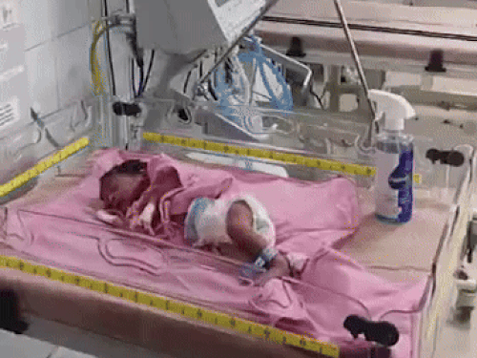
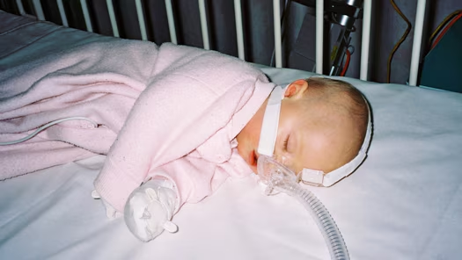
PREAMBLE
BABY INCUBATOR
A baby incubator is a specialized medical device designed to provide a controlled environment for newborns, especially premature infants. It maintains optimal temperature, humidity, and oxygen levels to support neonatal development.
SLEEP APNEA
Sleep apnea is a condition where a baby experiences temporary pauses in breathing during sleep, leading to oxygen deprivation and potential health risks. Detecting and addressing apnea early is crucial to prevent complications.
Baby Incubator
Sleep Apnea
PROJECT PHASE-II
Date: 17-09-2025
ATME College of Engineering, Mysuru

Slide 4
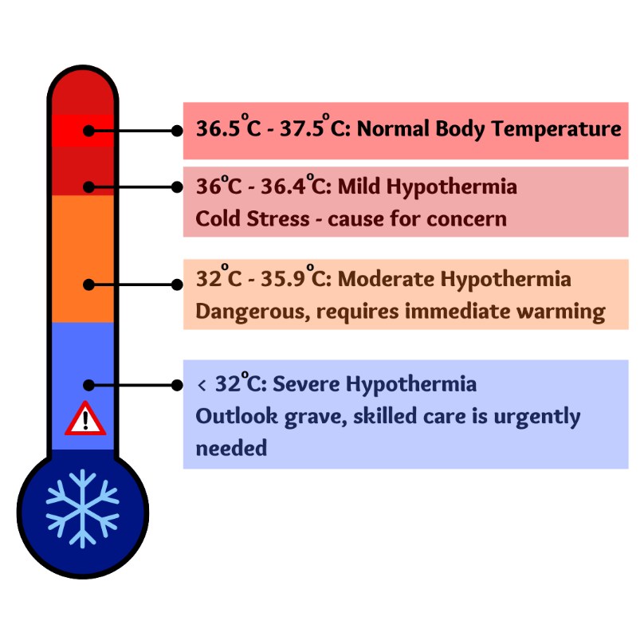
PREAMBLE
What is Hypothermia ?
Hypothermia is a condition in which the body temperature drops below the normal range needed for bodily functions, typically below 36.5°C . In newborns, especially preterm babies, hypothermia occurs more easily because they lose heat quickly and can’t regulate their body temperature well.
If not addressed, hypothermia can lead to serious complications, such as:
Low blood sugar (hypoglycemia): The body uses more energy to stay warm, depleting glucose levels.
Respiratory issues: Cold stress can make it harder to breathe.
Organ stress: Major organs, like the heart and brain, may function poorly at low temperatures.
To monitor such medical conditions baby warmer is helpful.
PROJECT PHASE-II
Date: 17-09-2025
ATME College of Engineering, Mysuru

Slide 5
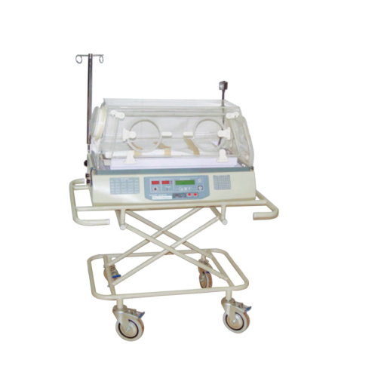
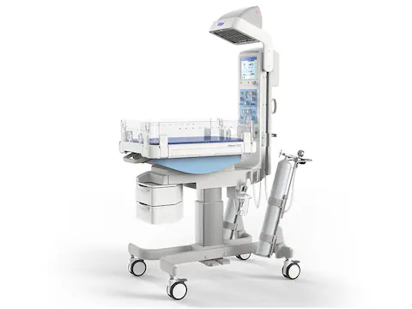
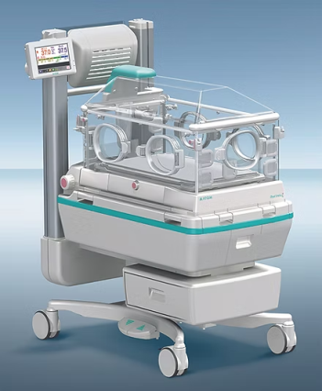
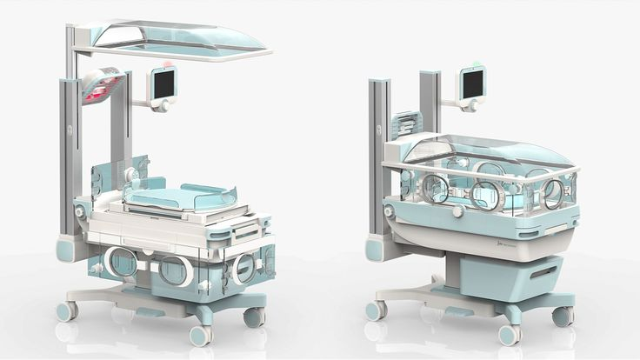
TYPES of INCUBATOR
Open Incubator: They are also called as Radiant warmer. Here the temperature is affected the external factors
Transport Incubator: Portable incubator used to transport neonates between hospitals or within medical facilities.
Closed Incubator: The temperature, humidity, and oxygen levels are all controlled completely
Hybrid Incubator: This is a combination both open incubator and closed incubator
PROJECT PHASE-II
Date: 17-09-2025
ATME College of Engineering, Mysuru

Slide 6
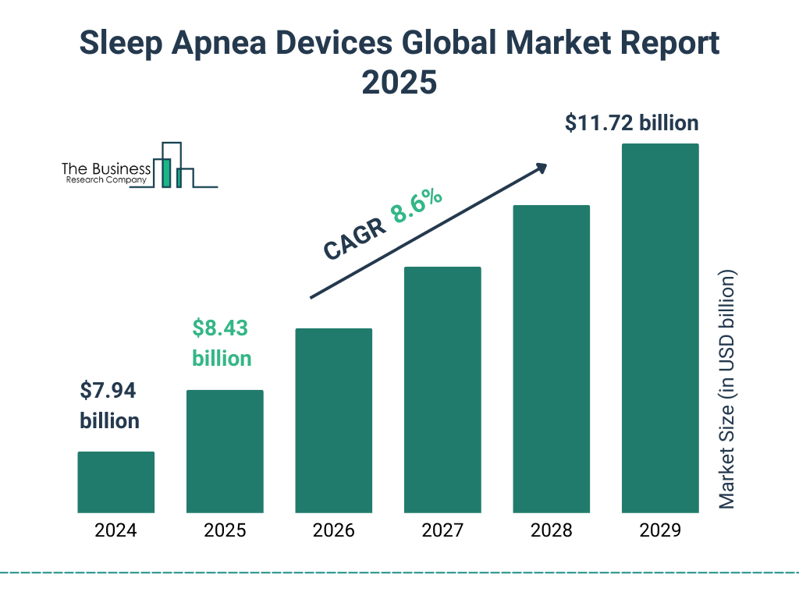
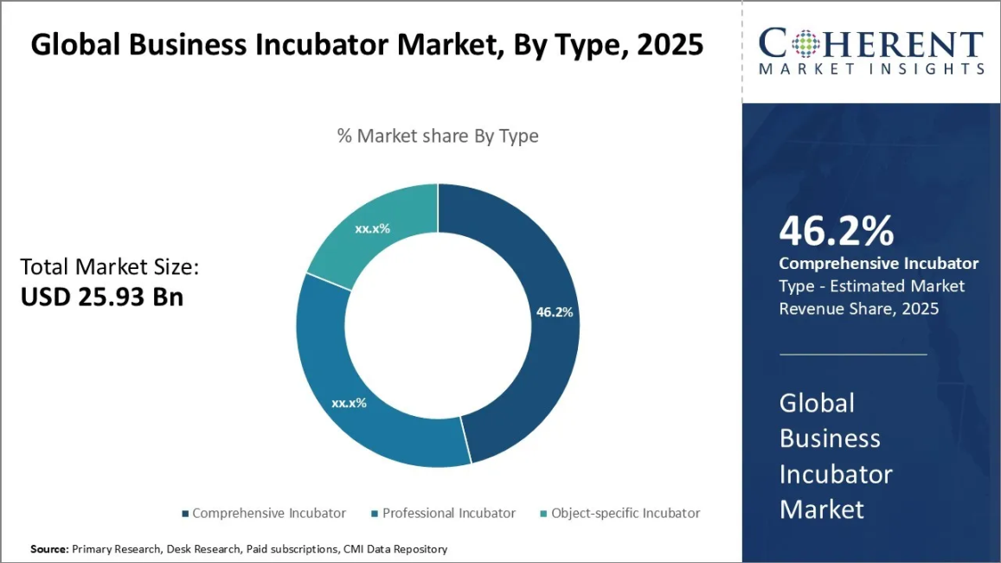
MARKET STATISTICS
Market Statistics of Sleep Apnea device
Market Statistics of Incubator
PROJECT PHASE-II
Date: 17-09-2025
ATME College of Engineering, Mysuru

Slide 7
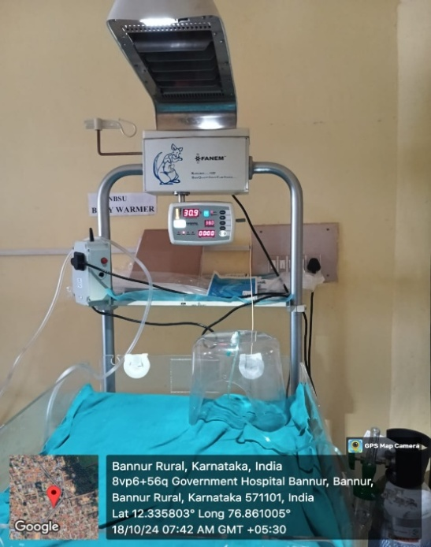
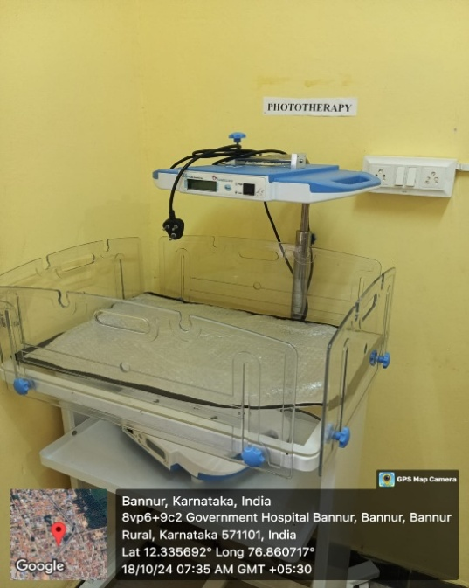
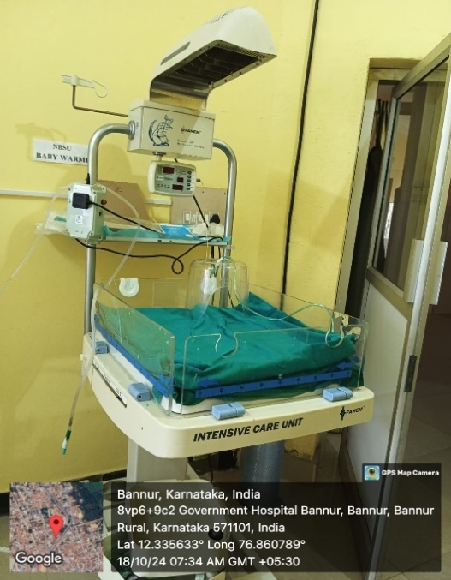
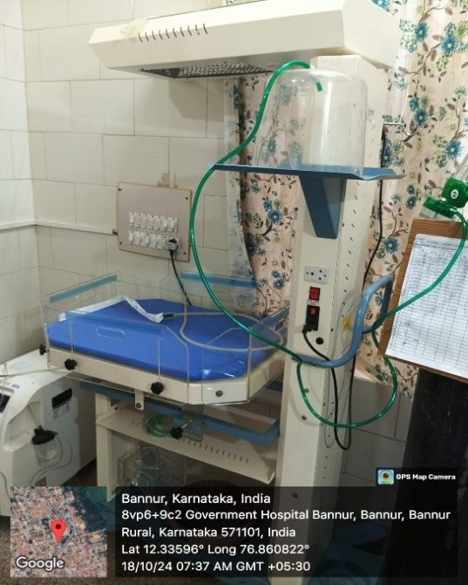
FEILD SURVEY
We visited the Government Hospital, Bannur, during our interaction we observed that they had 2 units where Incubators were present
All the incubators were very bulky and not portable
PROJECT PHASE-II
Date: 17-09-2025
ATME College of Engineering, Mysuru

Slide 8
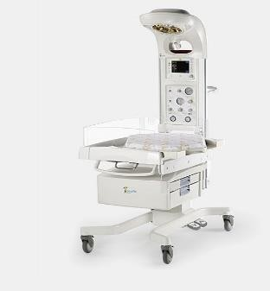
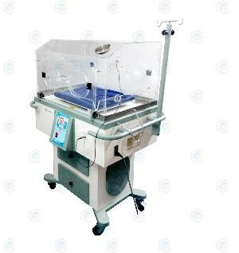
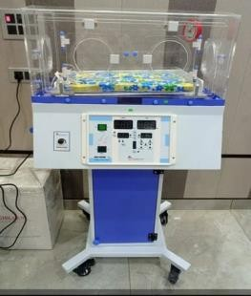
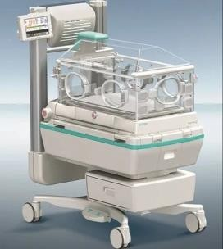
MARKET SURVEY
Sl. No | Commercial | Bed weight range | Cost | Figures
1 | GE Healthcare Giraffe Incubator | 300g-8kg | $2,574 to$6,655
2 | NICU product transfer baby incubator model name: Nugen | 0-25kg | $400 to$10,000
3 | PBI1200 | 0-20kg | $400 to$10,000
4 | Incubator and Infants warmers dual incubator | Up-to 13kg | $3,500 to$5,415
PROJECT PHASE-II
Date: 17-09-2025
ATME College of Engineering, Mysuru

Slide 9
PROBLEM DEFINITION
One of the most serious problems for new-born’s is sleep apnea, a disease in which breathing temporarily pauses, resulting in oxygen depletion and potentially fatal complications.
Furthermore, a lot of traditional incubators lack real-time vital sign monitoring, which is essential for identifying early indicators of distress including temperature swings, weight loss, or reductions in oxygen levels.
Sleep Apnea
PROJECT PHASE-II
Date: 17-09-2025
ATME College of Engineering, Mysuru

Slide 10
PROBLEM DEFINITION
Questions answered by the staff :
How frequently do you need to monitor the baby’s temperature manually while using the warmer?
Ans- Every 10 mins after delivery for about an hour or two.
Are there any specific temperature regulation issues that you encounter with premature or low-birth-weight infants?
Ans- Standard Temp - 36.5 deg celcius
cold weather - 37.5 deg celcius
Hot weather - 35 deg celcius
Premature - 37.5 deg celcius
PROJECT PHASE-II
Date: 17-09-2025
ATME College of Engineering, Mysuru

Slide 11
LITERATURE SURVEY
[1] Solomon Nwaneri, Beatrice Ezenwa1, Akinniyi Osuntoki2, Veronica Ezeaka1, Folasade Ogunsola “A review of infant apnea monitor design”, Clinical and Labora Research (2024)
Inference: From this paper ,there are various new-born apnea monitoring devices available, ranging from impedance pneumography and piezoelectric sensors to camera- based and capacitive sensing systems, each has inherent limits in terms of accuracy, comfort, cost, and susceptibility to false alarms.
[2] Cansu Celebioglu and Ayca Kumluca Topalli “IoT-based incubator monitoring and machine learning powered alarm predictions.”, Technology and Health Care (2024)
Inference:This paper discusses an IoT-based incubator monitoring system that continuously tracks important parameters like temperature and humidity, utilizing multiple sensors and machine learning for anomaly detection. This system is designed for real-time monitoring and alarm notifications, which could potentially be adapted for sleep apnea tracking in neonatal care. The focus remains on ensuring the safety and health of infants in incubators.
PROJECT PHASE-II
Date: 17-09-2025
ATME College of Engineering, Mysuru

Slide 12
LITERATURE SURVEY
[3] Srinivasan Balapangu Shankar, Mark Konyele Kuuziile, “Design of an Apnea Monitoring Device for Preterm Baby”, Research Square (2024)
Inference: Designing and implementing an apnea monitoring system for preterm neonates is the main subject of the study report. Vital indicators like heart rate, body temperature, and breathing rate are tracked using non-invasive sensors. Neonatal apnea episodes are detected by the device, which instantly notifies caretakers.
[4] Shreeshayana R1, Raghavendra L2, Manjunatha K B3 and Hemanth B S4 1Assistant Professor, Department of Electrical and Electronics Engineering, ATME College of Engineering, Mysuru, India “Portable Baby Incubator for Monitoring Sleep Apnea”, Grenze International Journal of Engineering and Technology (2023)
Inference: The study describes a portable infant incubator that uses DHT11 and pulse sensors to track neonatal vital signs like temperature and pulse rate. To enable remote monitoring, data is gathered using an ESP8266 microcontroller. In environments with limited resources or that are mobile, the system seeks to guarantee the security and dependability of newborn monitoring. LCD display is used for visualizing the readings.
PROJECT PHASE-II
Date: 17-09-2025
ATME College of Engineering, Mysuru

Slide 13
LITERATURE SURVEY
[5] Indira Chandrasekar 1, *, Mary Anne Tablizo 2,3, Manisha Witmans 4, Jose Maria Cruz 5, Marcus Cummins 6 and WendyEstrellado-Cruz 5 “Obstructive Sleep Apnea in Neonates”, Children, volume 9 (2022)
Inference: Neonates have distinctive anatomic and physiologic features that predispose them to obstructive sleep apnea (OSA). If remained unrecognized and untreated, neonatal OSA can lead to impaired growth and development, cardiovascular morbidity, and can even be life threatening. Polysomnography and direct visualization of the airway are essential diagnostic modalities in neonatal OSA.
[6] Hanna-Leena Kukkola1,2 and Turkka Kirjavainen1 “Obstructive Sleep Apnea in position dependent in young infants”, Pediatric Research, volume 93 (2022)
Inference: The study examines the effects of ambient noise on preterm newborns' early brain development in neonatal intensive care units (NICUs). According to the findings, sound management is crucial in NICUs, and quieter, developmentally appropriate settings are recommended to help vulnerable neonates' healthy neurodevelopment. This study provides important new data that connects early sensory experiences to the anatomical and functional consequences of the preterm infant's brain.
PROJECT PHASE-II
Date: 17-09-2025
ATME College of Engineering, Mysuru

Slide 14
LITERATURE SURVEY
[7] Kazim Sekeroglu-Southeastern Louisiana University, Harun Sumbul-Ondokuz Mayis University, Turkey, Ahmet Hayrettin Yuzer-Karabuk University, Turkey “A Novel Portable Real-Time Low-Cost Sleep Apnea Monitoring System based on the Global System for Mobile Communications (GSM) Network”, Medical and Biological Engineering and Computing, volume 60 (2022)
Inference: The paper focuses on a portable real-time low-cost sleep apnea monitoring system utilizing the GSM network, specifically designed for adult patients with sleep apnea. It does not address a portable neonatal incubator or its integration with sleep apnea tracking for neonates.
[8] Emmanuel Owusu, Felix Kwakye Darko “Portable Smart Neonatal Incubator with Improvised Alarm System”, Research square (2021)
Inference: The paper discusses a portable smart neonatal incubator that automates the monitoring of neonatal vitals using Internet of Things (IoT) technology. While it emphasizes improving alarm systems to combat alarm fatigue, it does not specifically mention sleep apnea tracking.
PROJECT PHASE-II
Date: 17-09-2025
ATME College of Engineering, Mysuru

Slide 15
LITERATURE SURVEY
[9] Gozde Cay, Dhaval Solanki, Vignesh Ravichandran, Laurie Hoffman, Abbot Laptook, James Padbury, “Baby-Guard: An IoT-based Neonatal Monitoring System Integrated with Smart Textiles”, Conference paper (2021)
Inference: A rising number of preterm babies demands innovative solutions to monitor them in the Neonatal Intensive Care Unit (NICU) continuously. NICU monitors various kinds of vital signs. Among them, there is a strong demand for an accurate and sophisticated technology to monitor respiration rate (RR) and detect critical events such as apnea.
[10] Rasha M. Abd El-Aziz, Ahmed I. Taloba “Real Time Monitoring and Control of Neonatal Incubator using IoT”, International of Grid and Distributed Computing, volume 14, (2021)
Inference: The neonatal incubator is a device used to nourish the premature babies by providing a controlled and closed environment. This incubator provides the babies with optimum temperature, relative humidity, optimum light and appropriate level of oxygen which are same as that in the womb.
PROJECT PHASE-II
Date: 17-09-2025
ATME College of Engineering, Mysuru

Slide 16
LITERATURE OUTCOME
There are problems with current apnea monitors, including false alarms, accuracy, comfort, and expense. Non-invasive, wearable, and low-power solutions are required.
Neonatal monitoring in real time with sensor-based alarms is made possible by IoT-enabled equipment. Both NICUs and remote locations benefit from these solutions' increased safety.
There is a focus on portable, affordable gadgets that use microcontrollers like the ESP8266. In places with limited resources, such methods are perfect.
Few apnea monitoring systems are designed specifically for neonates; the majority target adults. Babies' distinct physiology necessitates specialized monitoring systems.
Environmental elements that impact baby brain development include noise levels in NICUs. Additionally, monitoring systems ought to accommodate developmental demands.
PROJECT PHASE-II
Date: 17-09-2025
ATME College of Engineering, Mysuru

Slide 17
PROJECT OBJECTIVE
Objective-1: To develop an open-type modular incubator designed specifically for newborn and premature infants. The incubator will feature interchangeable components to enhance maintenance, adaptability, and future upgrades. A microcontroller-based system (Arduino) will monitor and regulate the artificial light source and ambient temperature. An integrated display unit will provide real-time feedback of environmental conditions.
Objective-2: To develop an integrated unit for continuous monitoring of the baby’s weight using a load cell, interfaced with a microcontroller and a digital display. This unit will be embedded within the incubator model, enabling real-time weight tracking to support clinical decisions and early detection of neonatal health issues.
Objective-3: To Monitor the Sleep Apnea in infants/Premature babies through observing the Readings of Vital stats such as SpO2 and Heart Rate along with Display and IoT integration. This shall be integrated in the model using Sensors, Controller and Display device.
A wearable device also will customized to monitor Temperature, Heart Rate, SpO2.
PROJECT PHASE-II
Date: 17-09-2025
ATME College of Engineering, Mysuru

Slide 18

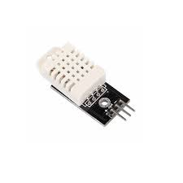
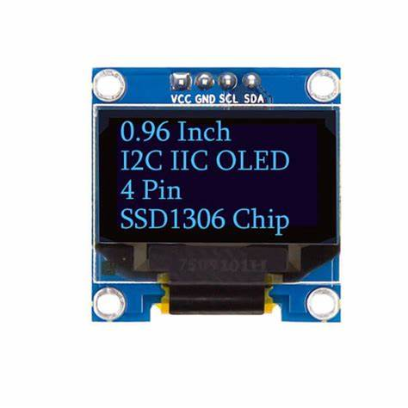
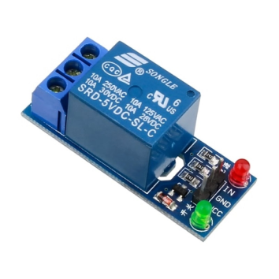
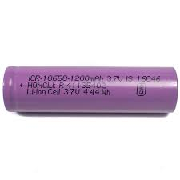
Objective 1
Hardware
Microcontroller (Arduino UNO) | DHT22 Sensor | OLED Display | Relay | Li-ion Rechargeable Battery (1200 mAH): 02 Quality
ATmega328: Operation Voltage: 5V Current: 20-50mA Pins: Analog Input Pins (6), PWM Digital I/O Pins (6) SRAM: 2 KB EEPROM: 1 KB. | Temperature Range: 0-50°C- Humidity Range: 20-90% RH- Accuracy: ±2°C, ±5% RH- Operating Voltage: 3.3V to 5V | - Screen Size: 0.96 inch- Resolution: 128x64 pixels- Operating Voltage: 3.3V to 5V- Interface: I2C | Operating Voltage: 5V or 12V DC Current Consumption: 70–100 mA Channel: NO, NC Com | Li-ion Rechargeable Battery: Normal Voltage: 3.7V Battery Capacity: 1200mAh Charge Voltage Range: 4.2V to 5.5V
PROJECT PHASE-II
Date: 17-09-2025
ATME College of Engineering, Mysuru

Slide 19
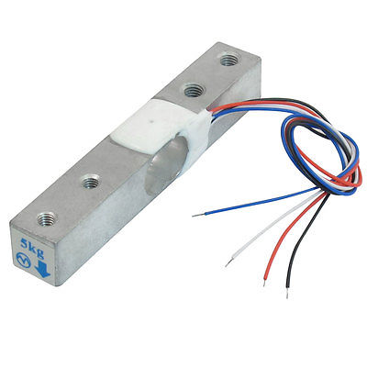
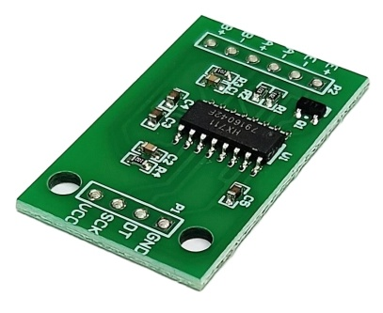
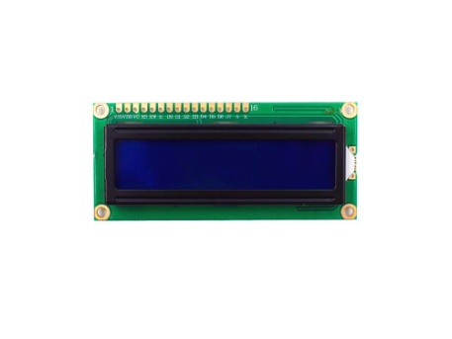
Objective 2
Hardware
Microcontroller (Arduino UNO) | Load cell | HX711 | LCD display | Battery
ATmega328: Operation Voltage: 5V Current: 20-50mA Pins: Analog Input Pins (6), PWM Digital I/O Pins (6) SRAM: 2 KB EEPROM: 1 KB. | Rated Capacity: 5 kg Rated Output: 1.0 ± 2.0 mv Input Resistance: ~1,000 Ω Output Resistance: ~1,000 Ω | Operating Voltage: 2.6V to 5.5V Current Consumption: < 1.5 Ma-< 1 µA | Display Type: Alphanumeric LCD Characters Displayed: 2 rows × 16 characters Character Size: 5×8 dot matrix Operating Voltage: 4.7V to 5.3V | Li-ion Rechargeable Battery: Normal Voltage: 3.7V Battery Capacity: 1200mAh Charge Voltage Range: 4.2V to 5.5V
PROJECT PHASE-II
Date: 17-09-2025
ATME College of Engineering, Mysuru

Slide 20
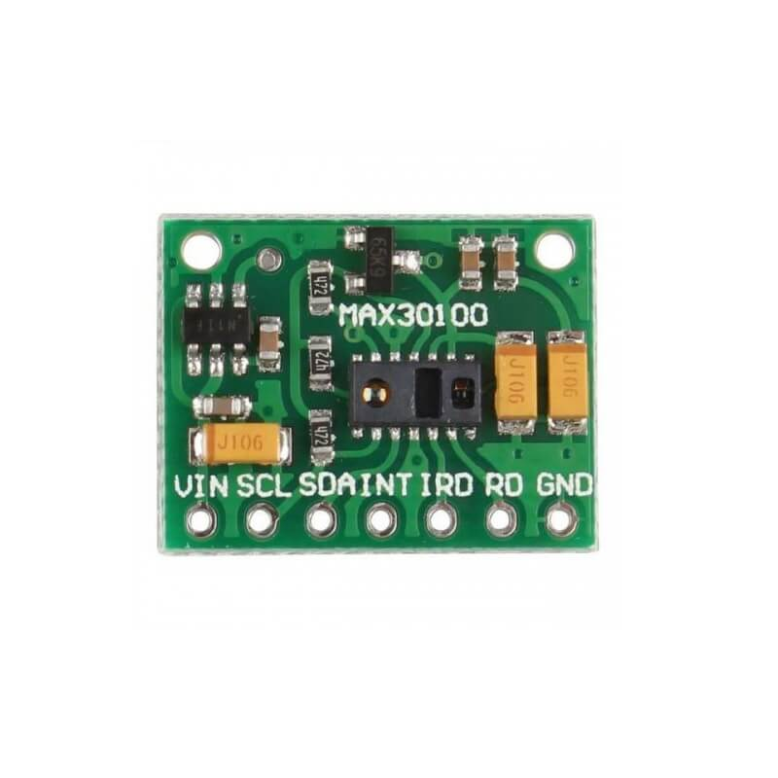
Objective 3
Hardware
Microcontroller (ESP8266) | MAX30100 | OLED Display | Battery
ATmega328: Operation Voltage: 5V Current: 20-50mA Pins: Analog Input Pins (6), PWM Digital I/O Pins (6) SRAM: 2 KB EEPROM: 1 KB. | Sensitivity: ±5V- Output Range: 0.5V to 3.5V (proportional to heart rate)- Operating Voltage: 3.3V to 5V | - Screen Size: 0.96 inch- Resolution: 128x64 pixels- Operating Voltage: 3.3V to 5V- Interface: I2C | Li-ion Rechargeable Battery: Normal Voltage: 3.7V Battery Capacity: 1200mAh Charge Voltage Range: 4.2V to 5.5V
PROJECT PHASE-II
Date: 17-09-2025
ATME College of Engineering, Mysuru

Slide 21
SOFTWARE
OBJECTIVE-1 | Arduino IDE and Language used : C
OBJECTIVE-2 | Arduino IDE and Language used : C
OBJECTIVE-3 | Arduino IDE and Language used : C
PROJECT PHASE-II
Date: 17-09-2025
ATME College of Engineering, Mysuru

Slide 22

METHODOLOGY
Objective 1:
DHT22
Temperature and Humidity Sensor
INPUT
RPS +5V DC
Organic Light Emitting Diode(OLED)
Screen
RELAY
LED Light
(ON OFF)
PROJECT PHASE-II
Date: 17-09-2025
ATME College of Engineering, Mysuru

Slide 23
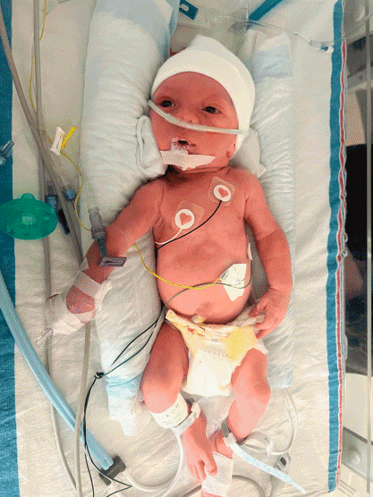
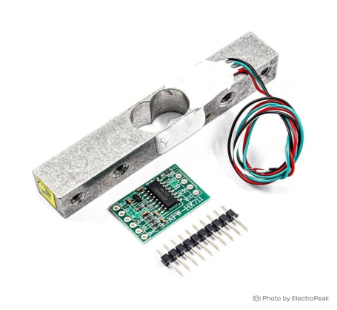
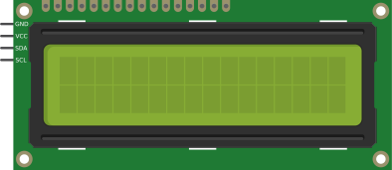
METHODOLOGY
Objective 2:
LOAD CELL with HX711
LCD Display
PROJECT PHASE-II
Date: 17-09-2025
ATME College of Engineering, Mysuru

Slide 24
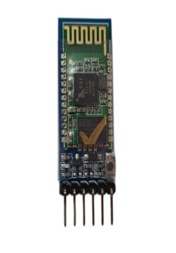
METHODOLOGY
Objective 3:
OLED
ARDUINO UNO
HCO5
PROJECT PHASE-II
Date: 17-09-2025
ATME College of Engineering, Mysuru

Slide 25
PHASE-II CONTINUE
PROJECT PHASE-II
Date: 17-09-2025
ATME College of Engineering, Mysuru

Slide 26
Mathematical Calculation
For obtaining Humidity:
Formula:
Humidity(%RH)=k × sensor signal output
Where:
k is a calibration constant specific to the DHT11.
The signal output is proportional to the capacitance change caused by humidity.
2. For obtaining Temperature:
The thermistor’s resistance R is related to the temperature T (in Kelvin) by the Steinhart-Hart equation:
1/T=A + B ln(R) + C(ln(R))ᶟ
PROJECT PHASE-II
Date: 17-09-2025
ATME College of Engineering, Mysuru

Slide 27

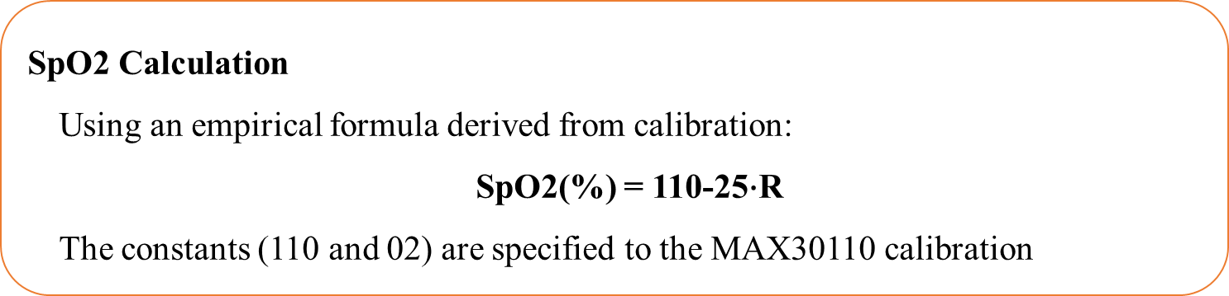
3. For obtaining Heart Rate:
4. For obtaining SpO₂ :
SpO2 Calculation
Using an empirical formula derived from calibration:
SpO2(%) = 110-25$∙$R
The constants (110 and 02) are specified to the MAX30110 calibration
PROJECT PHASE-II
Date: 17-09-2025
ATME College of Engineering, Mysuru

Slide 28
Flow Chart
START
OLED display
DHT22- Initialize
Read DHT22 Sensor
Relay
Load
Lamp source
(Off)
No
Loop Repeat
If Temp<35℃
Relay
Load
Lamp source
(On)
Yes
PROJECT PHASE-II
Date: 17-09-2025
ATME College of Engineering, Mysuru

Slide 29
Flow Chart
Start
Initialize Load cell
Read Load cell
Loop Repeat
If Load call>0
Display
Yes
PROJECT PHASE-II
Date: 17-09-2025
ATME College of Engineering, Mysuru

Slide 30
Flow Chart
Start
Initialize MAX30100
Read SpO₂
and BPM from MAX30100
Loop Repeat
Display
PROJECT PHASE-II
Date: 17-09-2025
ATME College of Engineering, Mysuru

Slide 31
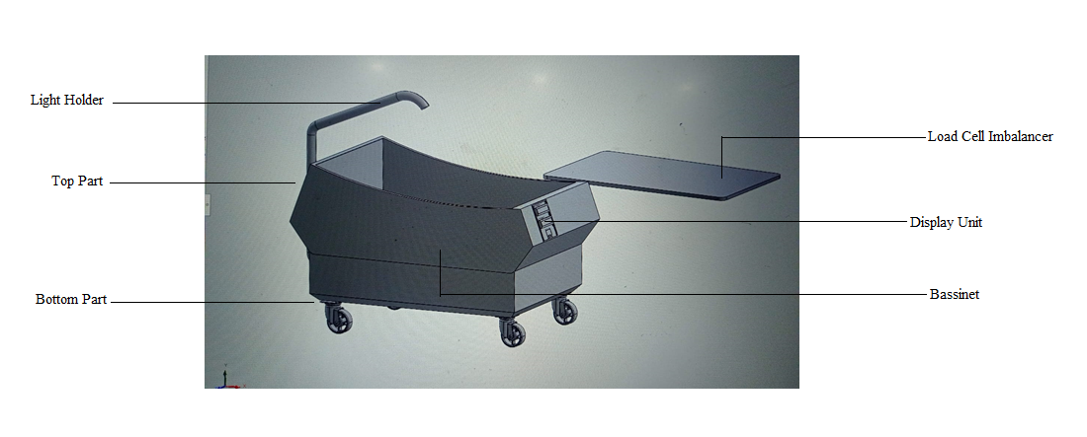
Design
3D Design
Open Type
PROJECT PHASE-II
Date: 17-09-2025
ATME College of Engineering, Mysuru

Slide 32
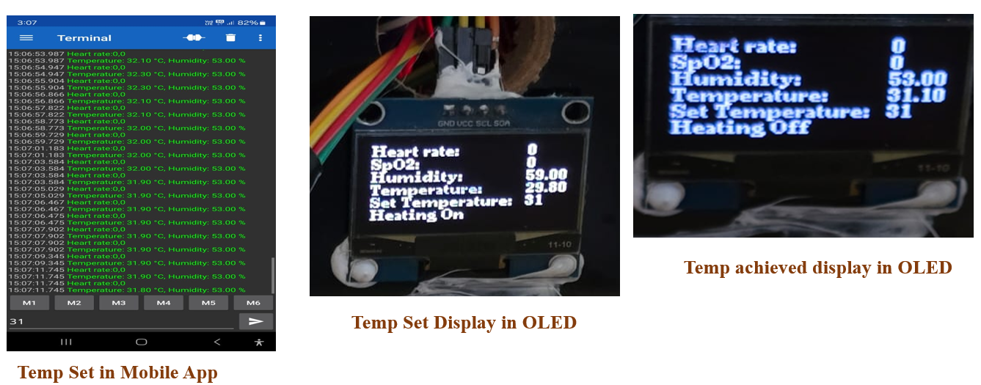
Result
Testing:
Sl. No | Temperature | Bulb Status
01 | 27℃ | ON
02 | 35℃ | OFF
03 | 36℃ | OFF
04 | 32℃ | ON
05 | 33℃ | ON
Sl. No | Weight | Displayed Weight
01 | 4kg | 3.90kg
02 | 2kg | 1.80kg
03 | 1kg | 0.9g
Bulb Status values
Weight monitored values
Results in App
PROJECT PHASE-II
Date: 17-09-2025
ATME College of Engineering, Mysuru

Slide 33
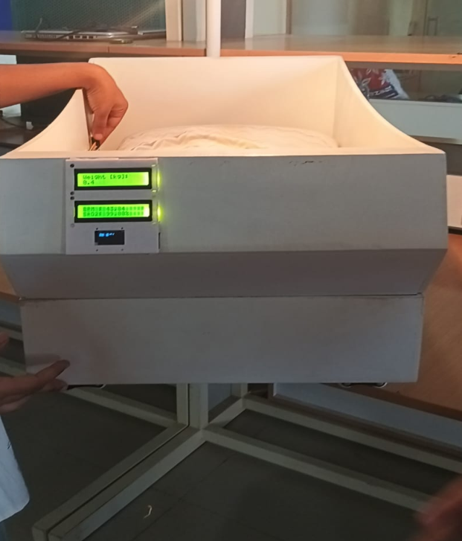
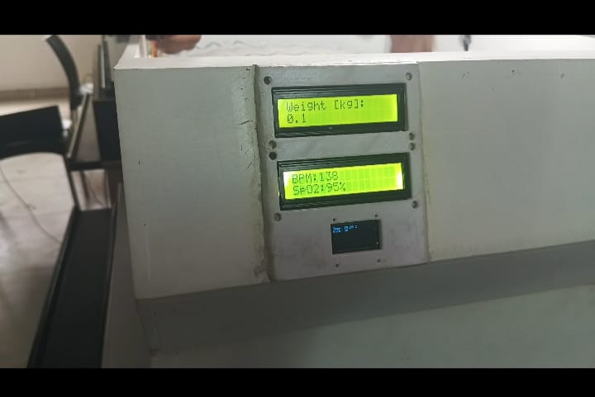
Result
Sl. No | BPM | SpO2
01 | 60 | 96
02 | 75 | 98
03 | 84 | 97
04 | 77 | 87
05 | 87 | 90
Sleep apnea monitored values
Model Working
Results Displayed in Model Display
PROJECT PHASE-II
Date: 17-09-2025
ATME College of Engineering, Mysuru

Slide 34
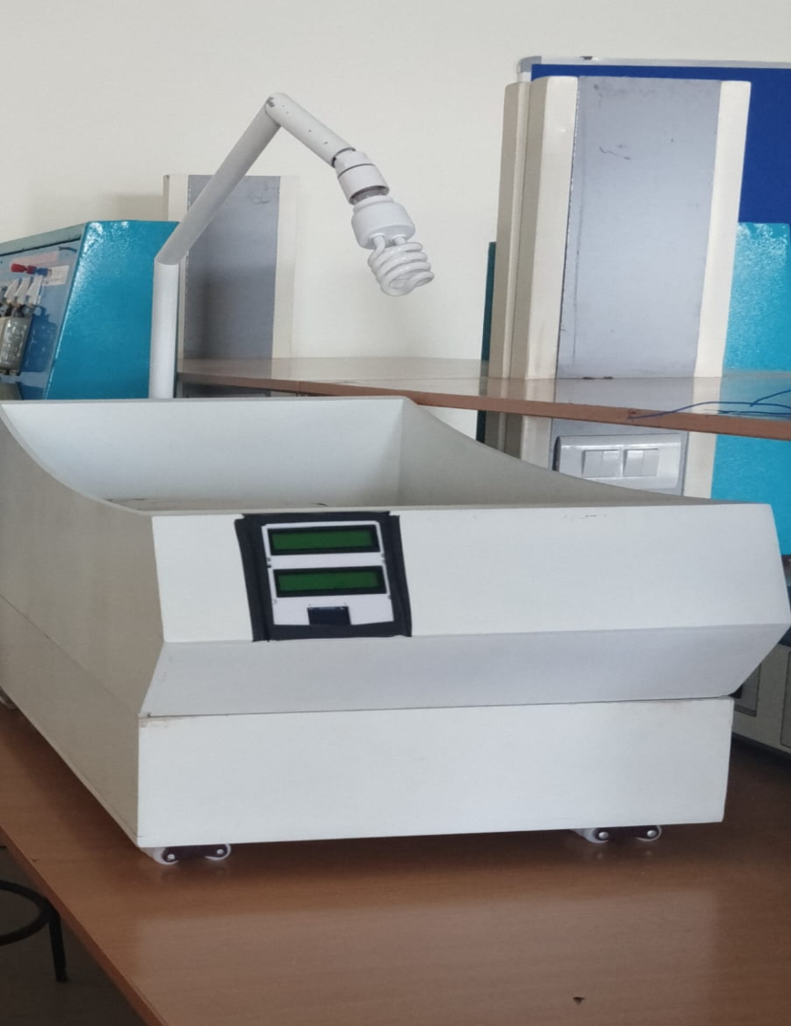
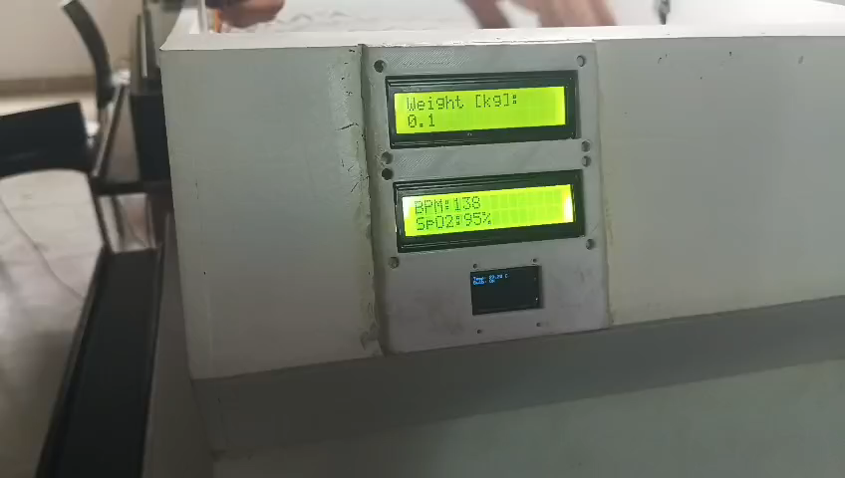
Result
Final Model
Model Working
PROJECT PHASE-II
Date: 17-09-2025
ATME College of Engineering, Mysuru

Slide 35
BUDGET
SI NO. | Description | Cost in ₹
1 | Hardware components | 10,000
2 | Fabrication | 6,000
3 | 3D-Design | 41,300
4. | Project Report | 1,000
5 | Miscellaneous | 10,000
TOTAL |  | 68,300
PROJECT PHASE-II
Date: 17-09-2025
ATME College of Engineering, Mysuru

Slide 36
TIMELINE
SI NO | PHASES | Feb 2025 | March 2025 | April 2025 | May 2025 | June 2025 | August 2025 | Sep 2025 | Oct 2025
1 | Project Feasibility study
2 | Time schedule and analysis
3 | Required analysis
4 | Components availabilities and purchase
5 | Design and implementation of Incubator with apnea monitor
6 | Testing of the model
7 | Report draft
8 | Report submission
9 | Paper draft
10 | Paper publication
PROJECT PHASE-II
Date: 17-09-2025
ATME College of Engineering, Mysuru

Slide 37
REFERENCE
[1] Solomon Nwaneri, Beatrice Ezenwa1, Akinniyi Osuntoki2, Veronica Ezeaka1, Folasade Ogunsola “A review of infant apnea monitor design”, Clinical and Laboratory Research, 2024
[2] Cansu Celebioglu and Ayca Kumluca Topalli “IoT-based incubator monitoring and machine learning powered alarm predictions.”, Technology and Health Care, 2024
[3] Srinivasan Balapangu Shankar, Mark Konyele Kuuziile, “Design of an Apnea Monitoring Device for Preterm Baby”, Research Square, 2024
[4] Shreeshayana R1, Raghavendra L2, Manjunatha K B3 and Hemanth B S4 1Assistant Professor, Department of Electrical and Electronics Engineering, ATME College of Engineering, Mysuru, India “Portable Baby Incubator for Monitoring Sleep Apnea”, Grenze International Journal of Engineering and Technology, 2023
[5] Indira Chandrasekar 1, *, Mary Anne Tablizo 2,3, Manisha Witmans 4, Jose Maria Cruz 5, Marcus Cummins 6 and WendyEstrellado-Cruz 5 “Obstructive Sleep Apnea in Neonates”, Children, volume 9, 2023
PROJECT PHASE-II
Date: 17-09-2025
ATME College of Engineering, Mysuru

Slide 38
REFERENCE
[6] Hanna-Leena Kukkola1,2 and Turkka Kirjavainen1 “Obstructive Sleep Apnea in position dependent in young infants”, Pediatric Research, volume 93, 2022
[7] Kazim Sekeroglu-Southeastern Louisiana University, Harun Sumbul-Ondokuz Mayis University, Turkey, Ahmet Hayrettin Yuzer-Karabuk University, Turkey “A Novel Portable Real-Time Low-Cost Sleep Apnea Monitoring System based on the Global System for Mobile Communications (GSM) Network”, Medical and Biological Engineering and Computing, volume 60, 2022
[8] Emmanuel Owusu, Felix Kwakye Darko “Portable Smart Neonatal Incubator with Improvised Alarm System”, Research square, 2021
[9] Gozde Cay, Dhaval Solanki, Vignesh Ravichandran, Laurie Hoffman, Abbot Laptook, James Padbury, “Baby-Guard: An IoT-based Neonatal Monitoring System Integrated with Smart Textiles”, Conference paper (2021)
[10] Rasha M. Abd El-Aziz, Ahmed I. Taloba “Real Time Monitoring and Control of Neonatal Incubator using IoT”, International of Grid and Distributed Computing, volume 14, (2021)
PROJECT PHASE-II
Date: 17-09-2025
ATME College of Engineering, Mysuru

Slide 39

PROJECT PHASE-II
Date: 17-09-2025
ATME College of Engineering, Mysuru

